Slide 1

Stats844 Final Project Advance Regression: Housing Sale-price determinants and estimation
Yiming Li 20803118
Department of Mathematics

Slide 2
Introduction
House price becomes one of the biggest problems almost for everyone in everywhere. The price is so high that many people are under the pressure of buying a house or the overwhelming house loan. Moreover, the growing house price makes people more panic and accelerates their buying plan.
This project aims to explore the real reasons behind the high house price, and how those factors impact the price of the house, in other words, using given housing information to predict the house price.
Hopefully, we can give some suggestions when customers buy a new house.
Notes:
Our project is house price prediction. Our response variable is SalePrice and we have 79 variables to set up the model. The variables are either continuous or categorical. Our goal is to predict the sale price using these 79 variables.

Slide 3
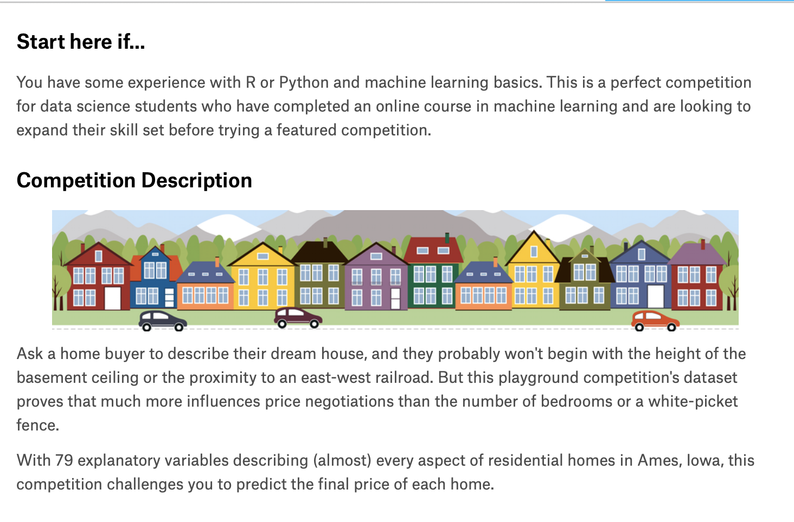
Dataset Overview
Small dataset, but good for training and practice !
Source: Kaggle
Size: 1460*81
main variables:
Sales price(response variable)
Ground living Area
Overall material Quality
Roof material
Type of foundation
Central Air Condition
Electrical system
Year garage was built
Fence quality
Month Sold , Year Sold
Notes:
So, what do we care about? How is the overall quality? What year was the house built? When is it remodelled? How big is the house? How many bedrooms are there? How many full and half bathrooms? How big is the lot? What neighborhood is the house in? How big is the garage? When is it built? What type is the garage? Is the driveway paved? Does the house have a pool? Does it have a fence? Does it have central air and heating? And etc.

Slide 4
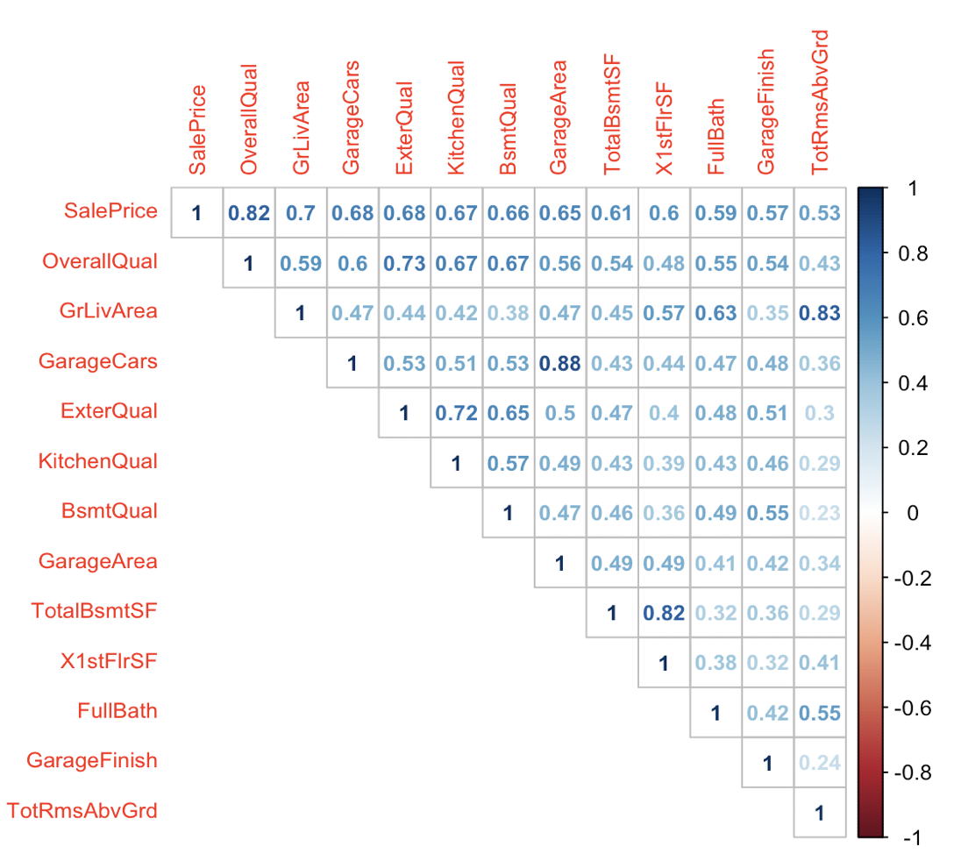
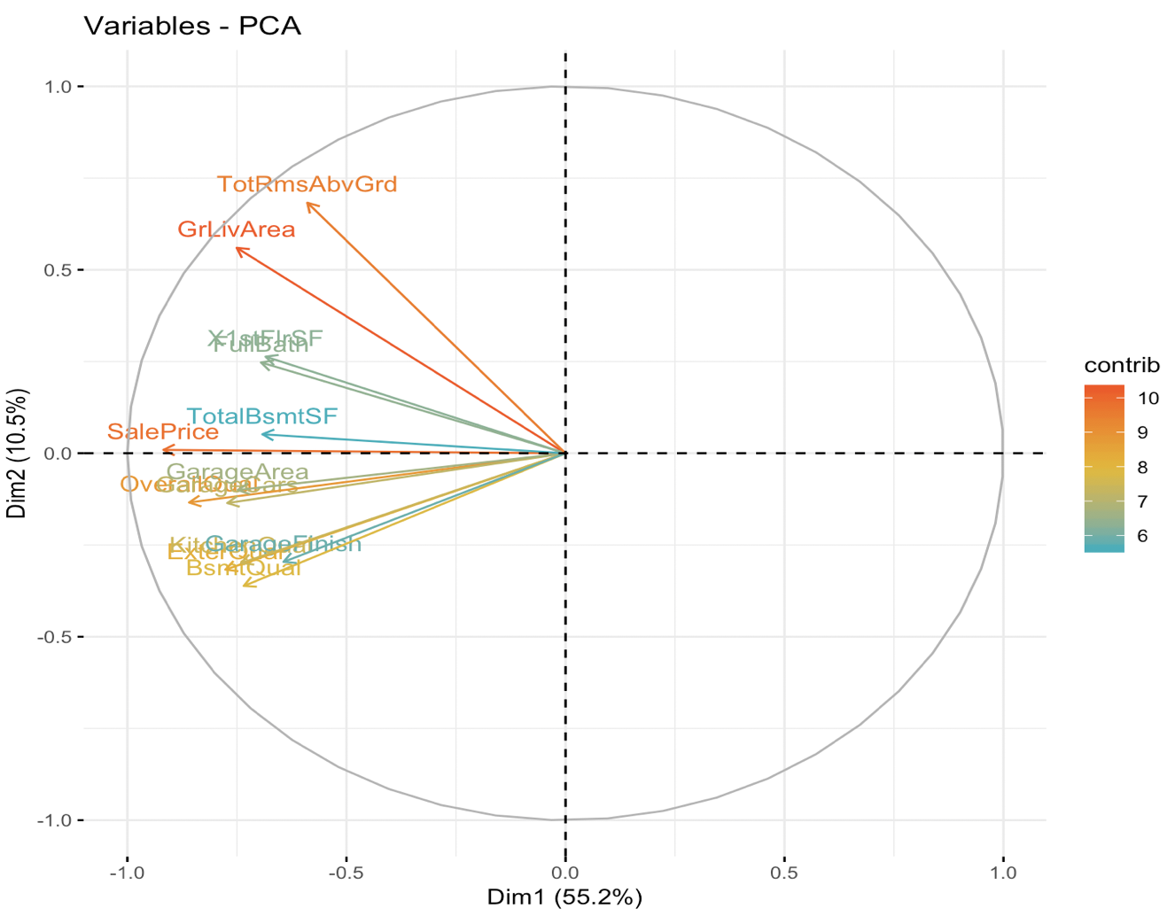
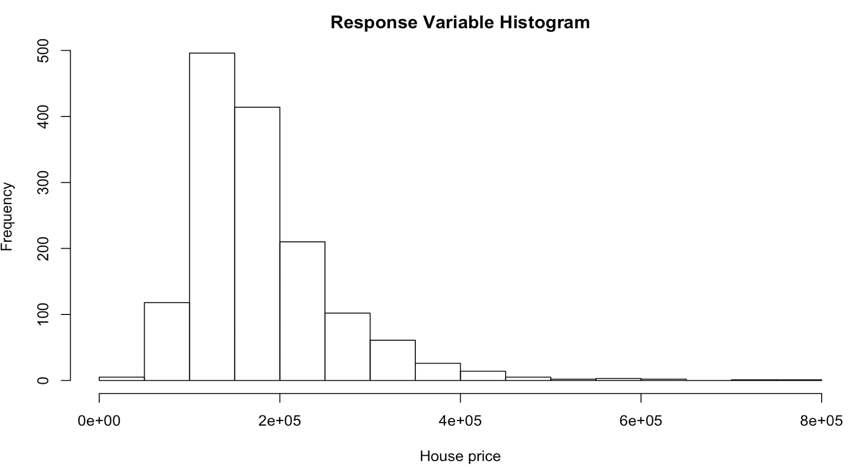
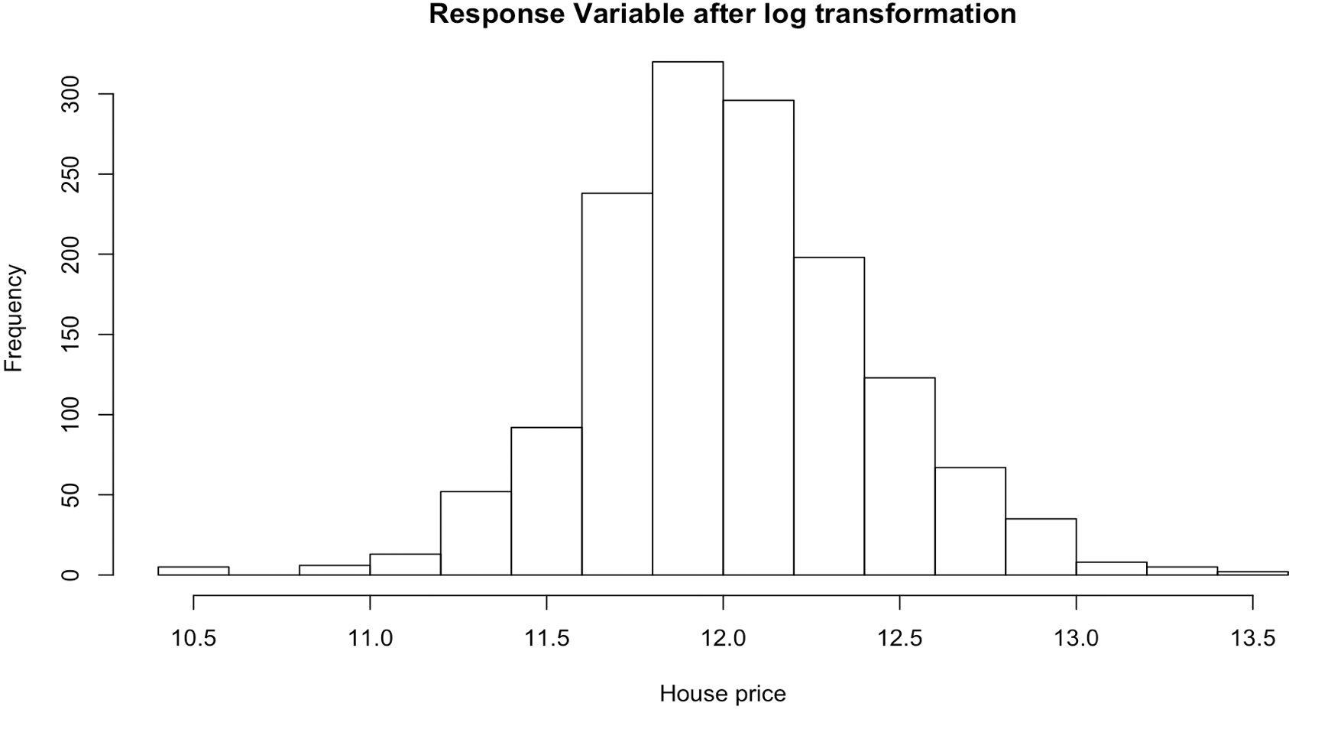
Data Preprocessing
Raw Data
step 1: Transforming some numerical variables which should be categorical into categorical(ex:‘YrSold’,‘MoSold’,‘YearBuilt’)
PCA top 10
Numeric
Fill NAs with
with Median(numeric)
and Mode(Category)
Filter correlation >0.5
step 2:Transforming categorical variables which have ordering meaning into numerical.
Feature
Selection
Standardize and log transformation
Log transformation for Sales price
step 3: Unifying the type of no order-meaning Categorical variables as factor.
Category
Combine
Stepwise regression(both backward and forward)
Processed Data:
1460*173
One-hot encoding
(dummies)

Slide 5
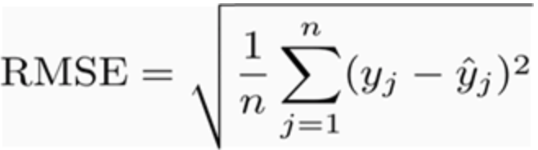
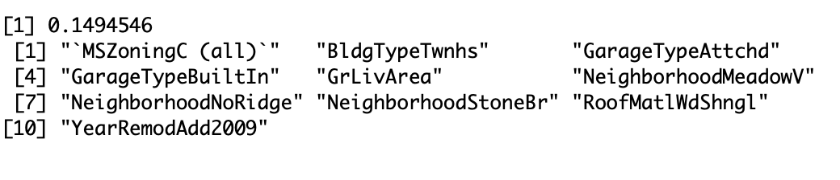
Linear Model
linear Regression : 5–fold cross validation, record RMSE of each fit, use average RMSE as score
We also keep top 10 absolute coefficient each time and make a table of importance feature for further analysis.
How do they determine the Salesprice?
Notes:
‘MSzoingC(all)’: the general zoning classification of the sale is commercial
‘BldgTypeTwhs’: Type of dwelling is Townhouse End Unit
‘GrlivArea’: Above grade (ground) living area square feet
‘RoofMatlWdSgngl’: Roof material Wood Shingles

Slide 6
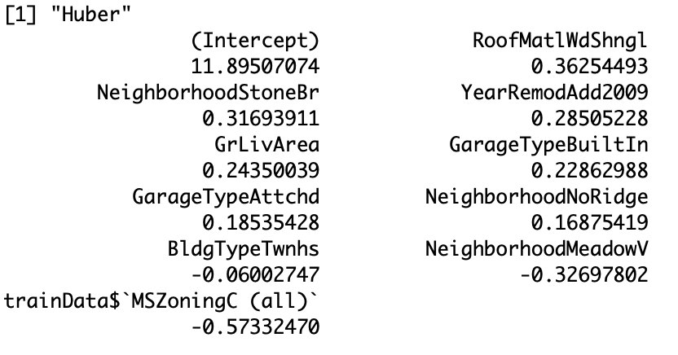
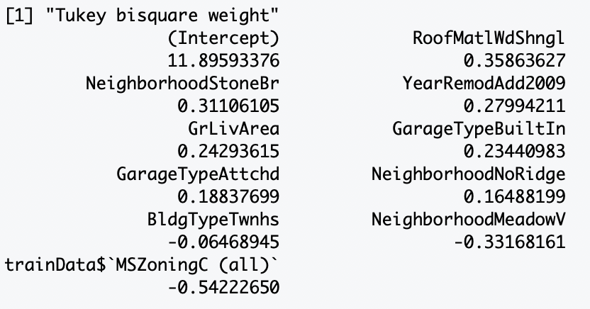
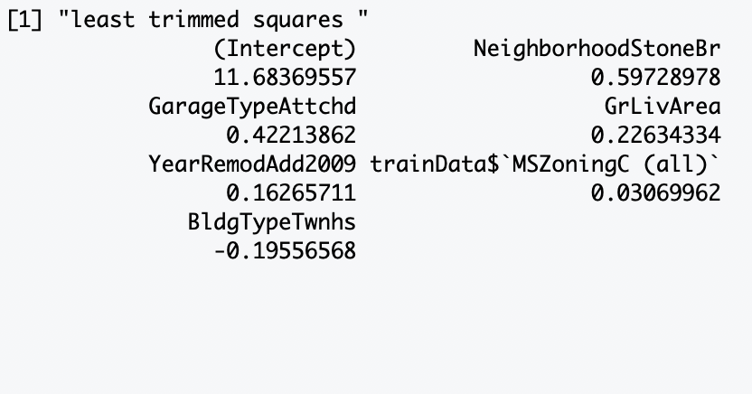
Robust Regression
We fit a linear regression for the top 10 variables find in last past,
But this time, we use Huber psi M-estimator, Tukey bisquare weight- M-estimator and least trimmed
squares estimator.
GrlivArea, the only one numeric in top 10
Let’s talk about the only one
Notes:
It is clear that the order of those important variables are the same, and their coefficients are similar
too(Due to the singular problem happens when fit least trimmed squares estimator,we don not contain
GarageTypeBuiltIn,NeighborhoodMeadowV,NeighborhoodStoneBr,and RoofMatlWdShngl in the model).
RoofMatlWdShngl(Wood Shingles) has the largest positive coefficient in Huber and Tukey models, while
MSZoningC(a commercial zoning classification of the sale) has the most negative influence to the sale price,
While it shows a positive influence in least trimmed squares estimator model. Moreover, BldgTypeTwnhs(Type
of dwelling:Townhouse Inside Unit) has a negative impact in all 3 models.

Slide 7
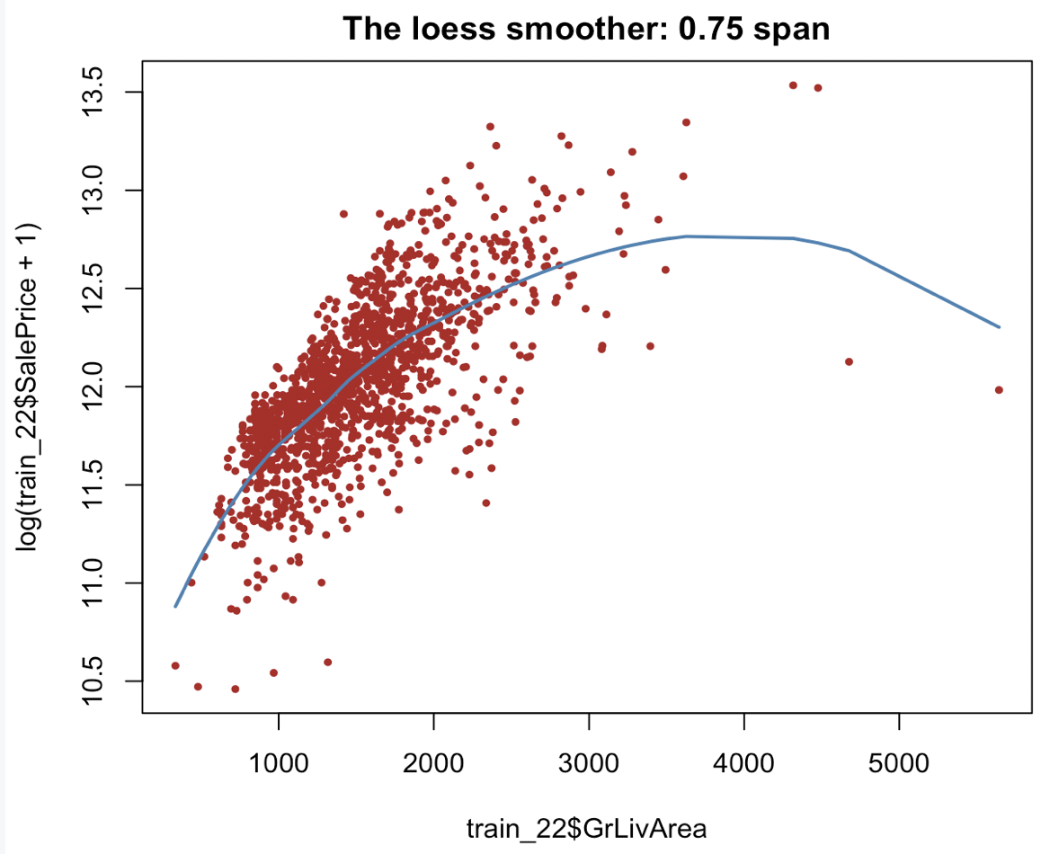
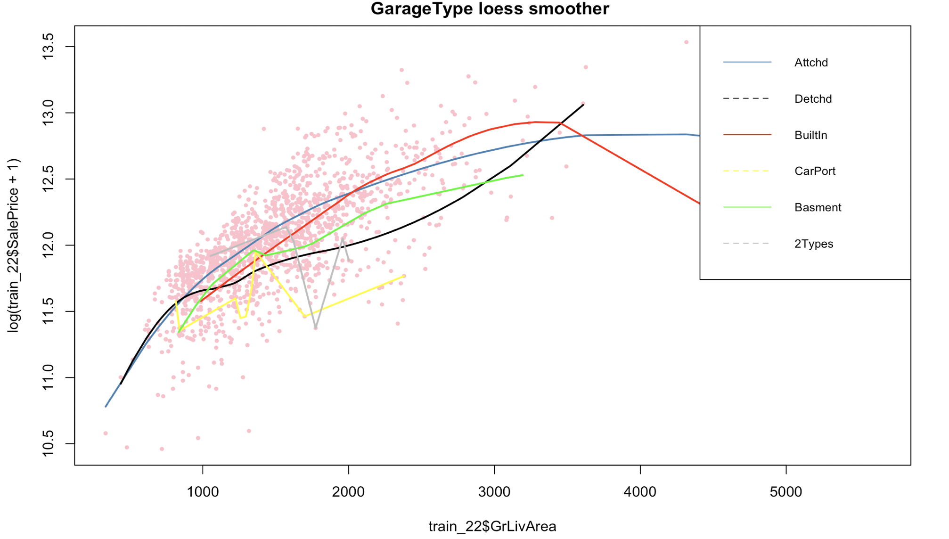
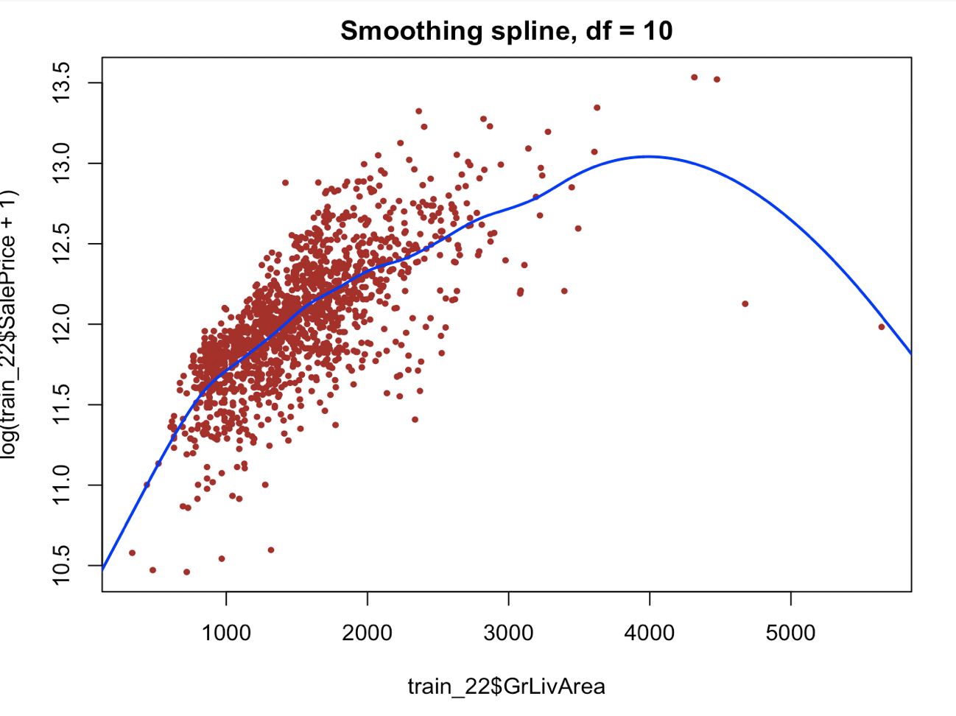
Smoothing method
---------Numeric & Category
Loess(Salesprice~GrLivArea)
Divide by Garage type
Better !
But why Salesprice decrease
>?<
VS
Notes:
The graph shows that for house having GrLivArea over 4000, their garage is either Attached or Built in.Since
Built in garage and Attached garage are also counted as part of the GrLivArea, the real GrLivArea for most
house so-called over 4000 GrLivArea may not true, or less than 4000, which is definitely a negative impact
for a luxury big house. Other reasons for decreaing price might be the worse design for Built in garage and
Attached garage in terms of indoor appearance or Practicality.

Slide 8
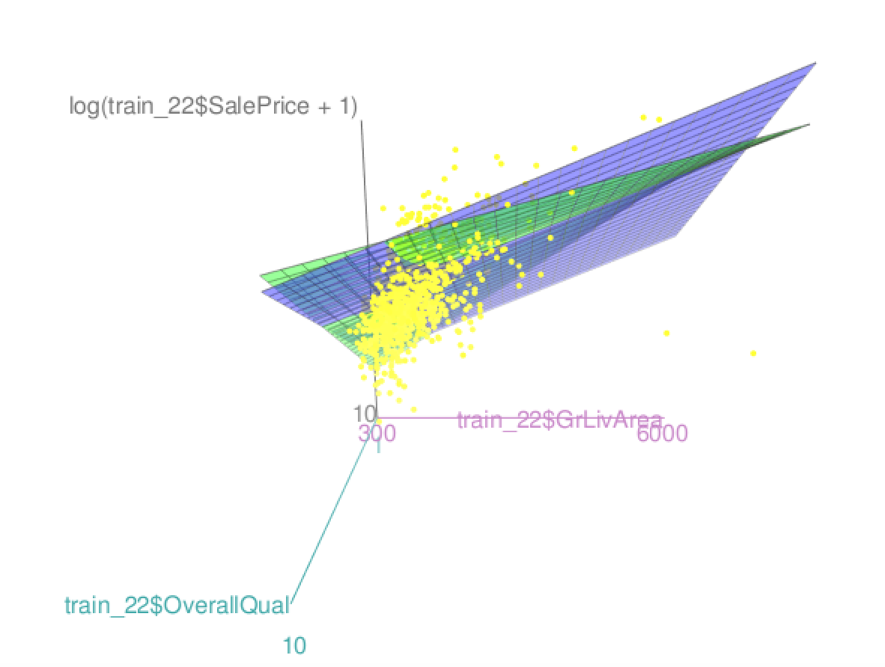
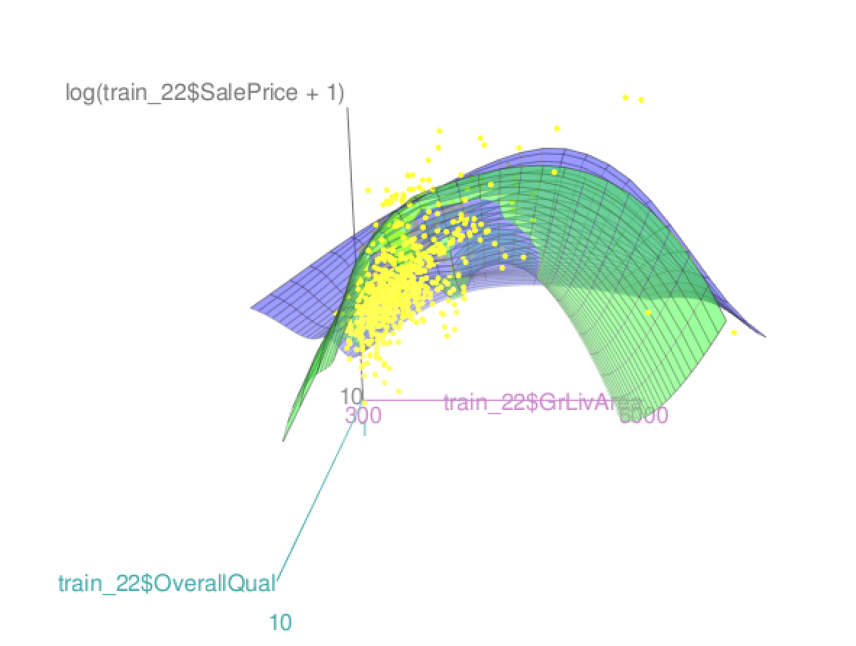
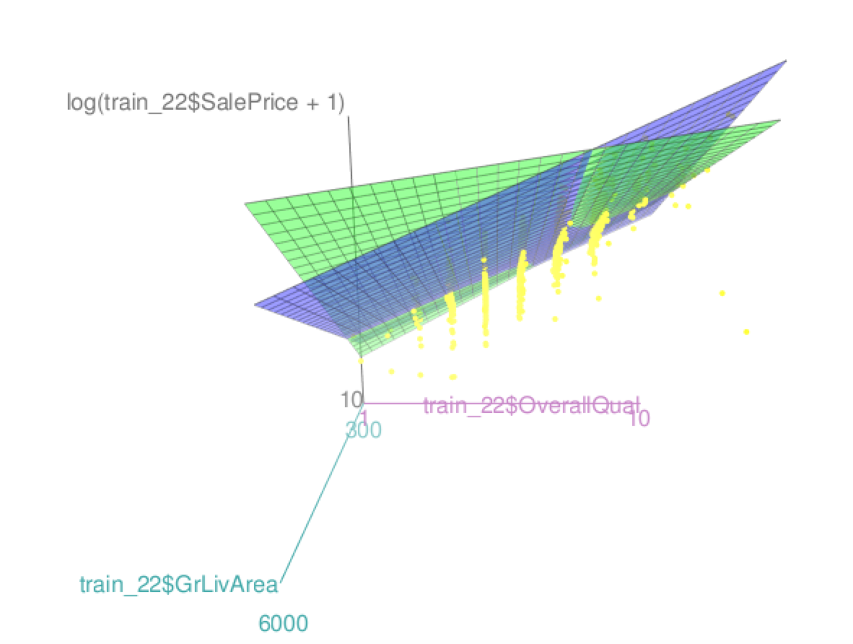
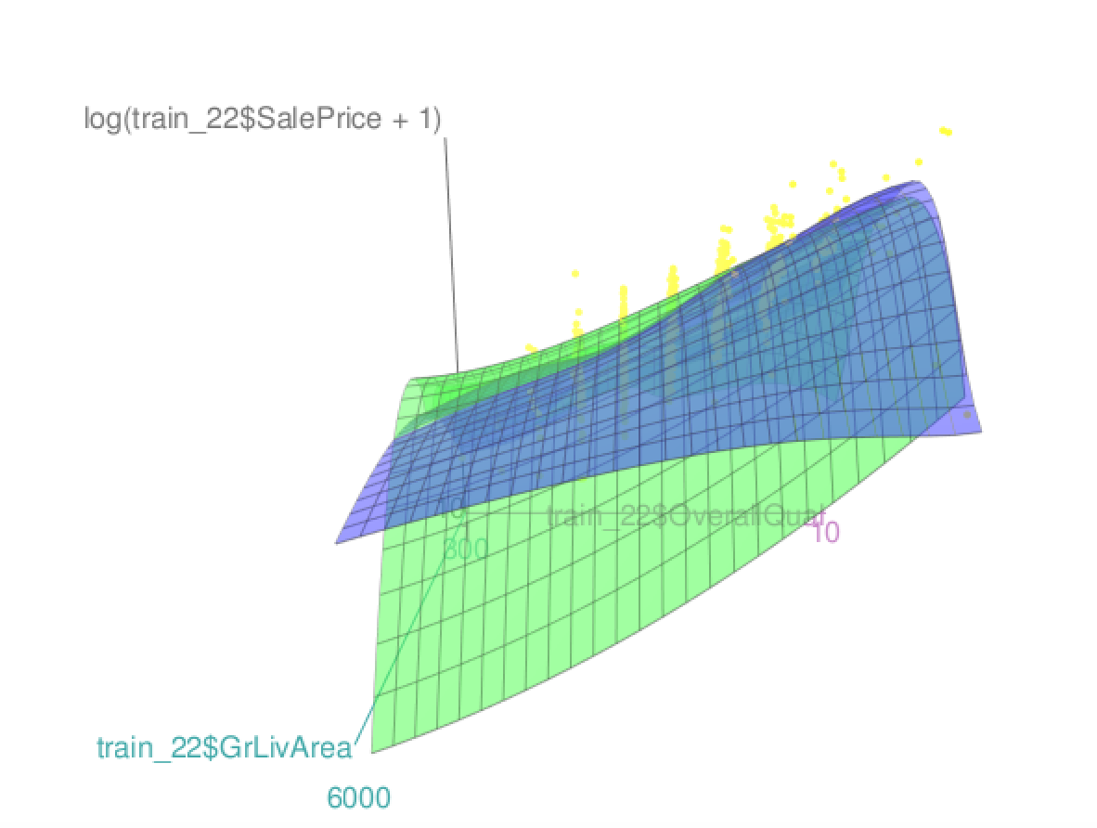
Smoothing method
---------Numeric & Numeric
In the smoothing part, we also trained a Lasso model, Skip it because of the time limit
Multiple Linear & interaction
(Salesprice~GrLiArea+OverallQual)
Multiple Smoothing Spline & Loess
(Salesprice~GrLiArea+OverallQual)
Notes:
it is intersting to see that there is a negative
interaction between OverallQual and GrLivArea, in other words, the blue plane is above the green one when
both factors have a big value.
For right-side models ,We can see from two graphs that when 2 explanatory variables are small, blue plane is under the green plane,
which means the smoothing model’s predicted price is small than that of loess. However, when two variables
become large, the green plane is always above the blue plane, and smoothing model has a higher predicted
Saleprice. We can conclude that the smoothing method is more sensitive to those outliers with pretty large
values than loess method.

Slide 9
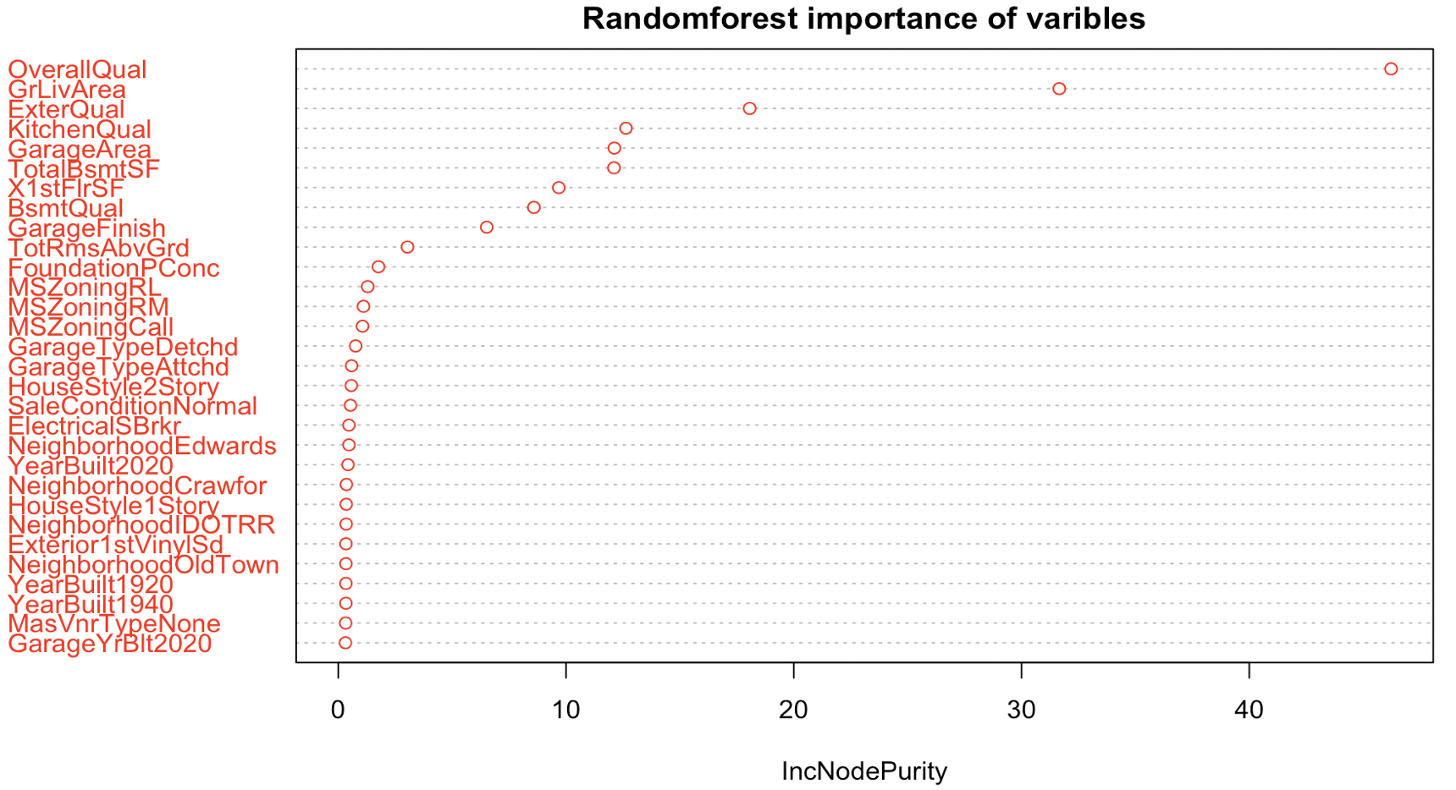
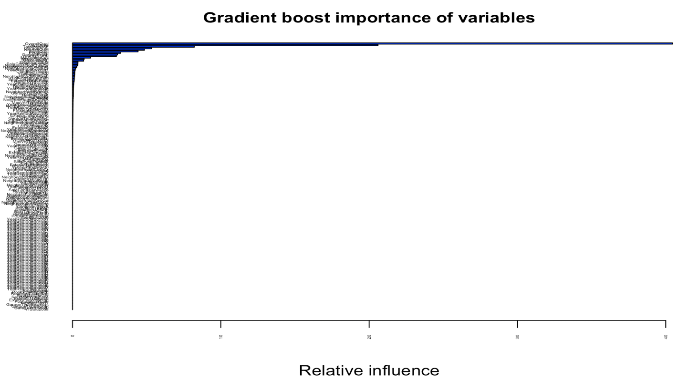
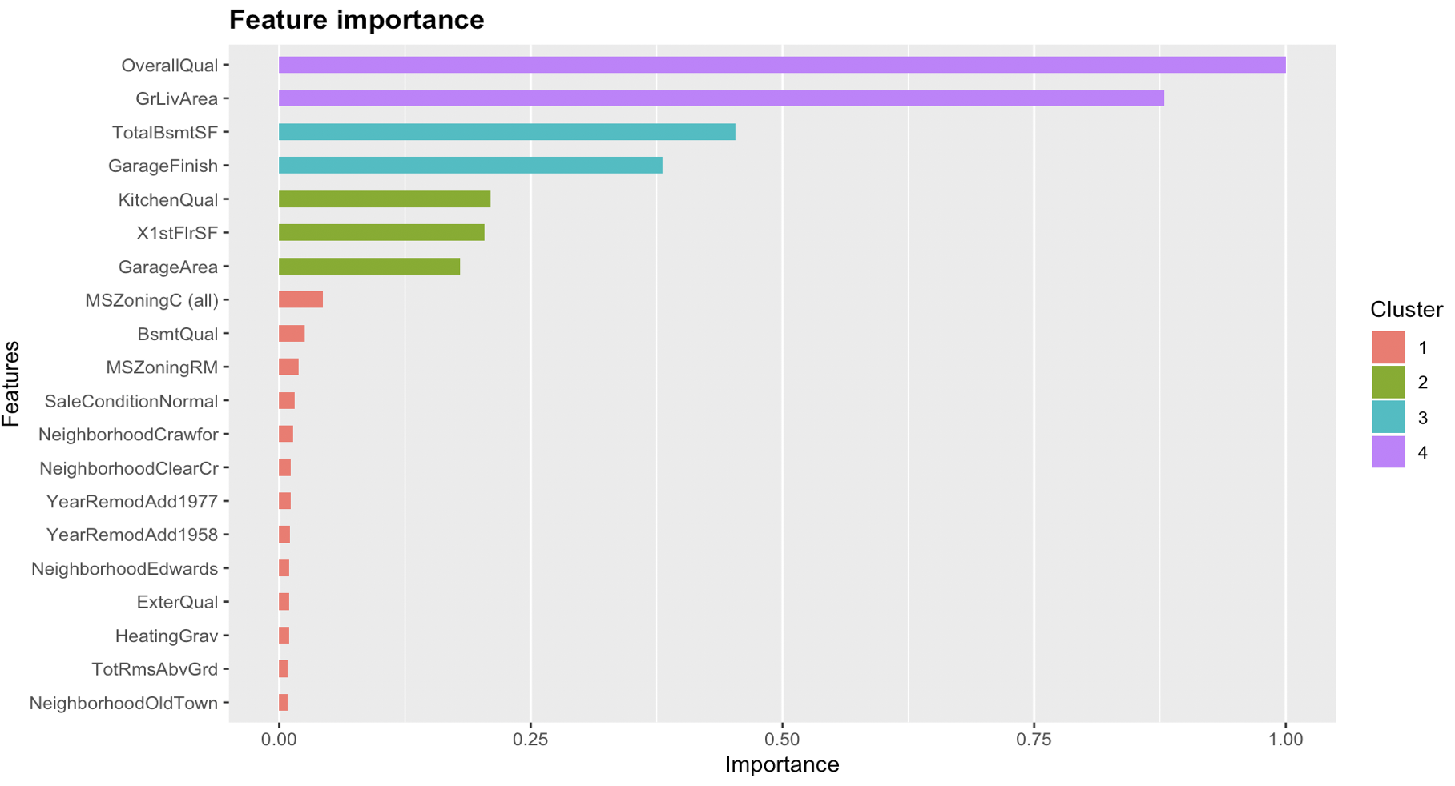
Tree based models
We use 3 tree models, random forest, and Xgboost
We also use 5-fold cross validation, use average RMSE as scores and extract the top 10 features

Slide 10
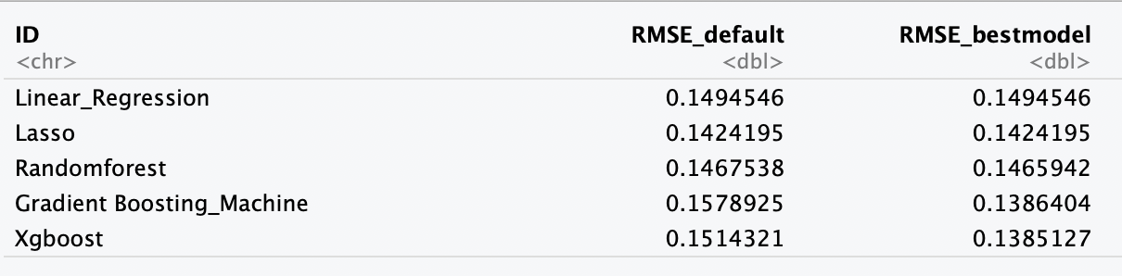
Conclusion
Winner is Xgboost!!!
We use Caret package to do hyperparameter tuning
But if training time matter, I prefer Lasso
Notes: No hyperparameter tuning for Liner regression and Lasso model
Notes:
We can see that alought RMSE of 5 models are very close, before hyperparameter tuning, tree models’s results are worse than linear models, while after hyperparameter tuning, Xgboost and Gradient
boosting machine give us lower RMSE, so I will say those two model are the best. However, if we also consider
about training time, lasso model is more efficient, because, it spends much more time to train a Xgboost or
Gradient boosting machine model, and the time used on hyperparameter tuning is relatively long.

Slide 11
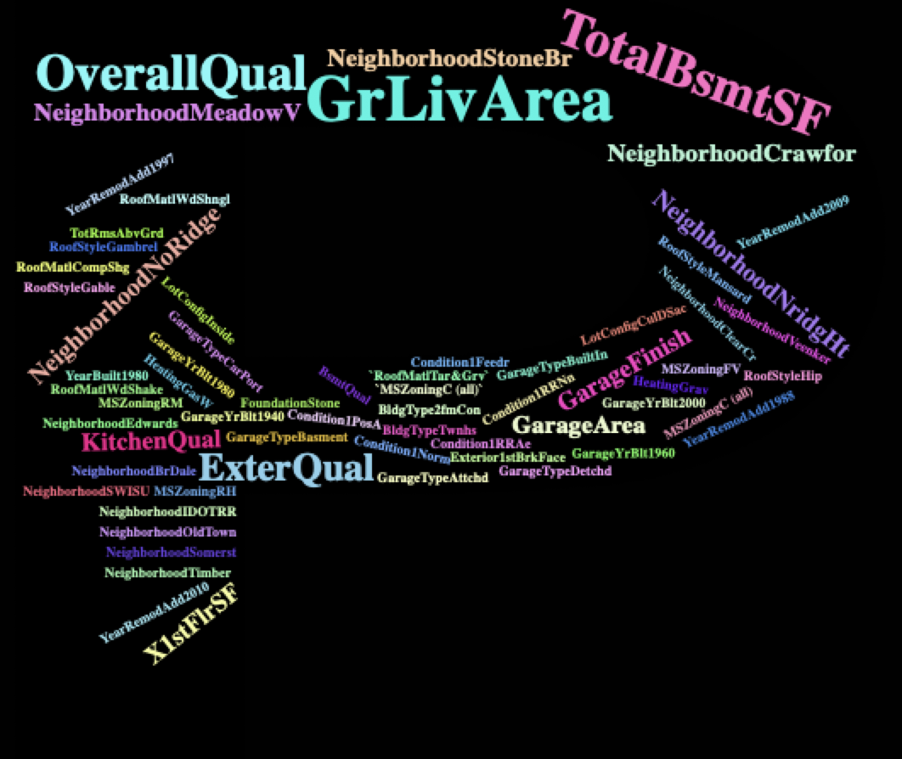
Some suggestions from a Rookie Data Scientist
Notes:
According to our project, it is hard to predict the housing Saleprice in Ames, Iowa with a high precision,
because there are too many factors can impact the Saleprice. However, we do find some top important
features, which shows up in any method we apply.
The first one is GrLivArea(Above grade (ground) living area square feet), the larger the area„ the higher the
price. However,it is not the case for house having a GrLivArea over 4000, as the Area of built-in basement will
be counted as part of those house. Moreover, OverallQul(overall quality), ExterQual(Evaluates the quality of
the material on the exterior), and KitchenQual(kitchen quality) are also importnat factors, the better the
quality, the higher the price.
Other significant factors are Neighborhood, and RoofMatl(Roof materials). Houses located in StoneBr(StoneBr
Stone Brook) and NoRidge(Northridge) are usually with a higherprice, while house in MeadowV(Meadow
Village) is the way cheaper.
In addition, if it is possible, remember to identify the general zoning classification of the sale as Commerical,
as the salesprice often lower in this method of transaction.

